Slide 1
SKYAERO
“I shot an arrow toward the sky
It hit a white cloud passing by
The cloud fell dying to the shore
I don’t shoot arrows anymore”
- Shel Silverstein

Slide 2
Topics
Introduction & Overview
Events & Phases
Coordinate Frames
Dynamics & Equations of Motion
Numerical Integration
Geodesy & Gravity
The Atmosphere
Coriolis Corrections
Singular Perturbations

Slide 3
Topics
Introduction & Overview
Events & Phases
Coordinate Frames
Dynamics & Equations of Motion
Numerical Integration
Geodesy & Gravity
The Atmosphere
Coriolis Corrections
Singular Perturbations

Slide 4
Objective
Our Objective is to use trajectory simulation (SKYAERO7.5) to support
  Performance estimation during rocket design
  Mission Planning
  Range safety as part of range ops
  Launcher adjustments to compensate for winds
SKYAERO7.5 applicability
  With an extended atmosphere model, generally valid for sounding rockets with apogees less than ~500 km launched anywhere on Earth
  Applies to rockets flown from the FAR Site and the MTA with their 15 km max apogee constraint
  Applies to ESRA rockets flown from Green River, Utah

Slide 5
Trajectory Simulation Overview
Trajectory Simulation has driven computer hardware for centuries
  The slide rule…the key to Napoleon’s artillery effectiveness &, in turn, his victories
  The Analytic Engine…an outstanding achievement of Victorian England
  ENIAC…the first electronic computer (1945)…designed for trajectory simulation
Trajectory simulation physics & math discovered by Isaac Newton
  The problem discussed today is taught in high school physics
But, nearly all naïve attempts to create trajectory simulation software fail
WHY? Two broad reasons:
  There are many possible coordinate systems, state vector definitions, integrators & interpolators, etc. Most such combinations have numerical flaws/singularities. Very few will lead to success.
  Poor development strategy

Slide 6
SKYAERO7.5 Overview
SKYAERO is a two degree of freedom (2DOF) point mass time-event simulation. SKYAERO is written in Microsoft™ Excel using Visual Basic functions and subroutines
SKYAERO7.5 can simulate 0 or up to 3 powered stages with the 1 as the default. It also can simulate both attached and separated payloads such as a dart.
SKYAERO is written in a launch-centered Cartesian frame whose two coordinates are altitude and range. Note that the frame rotates with the earth, and is therefore not inertial
SKYAERO assumes zero aerodynamic lift…Velocity vector rotates instantly to point into the relative wind. Wind response uses Lewis method
Integration uses a fourth order Runge-Kutta scheme. Tabular interpolation uses a linear relation between points. Events are timed to the end of the integration step in which they occur.
Regular perturbation corrections for the effects of earth rotation (coriolis corrections) must be done off line. Singular perturbation corrections for launcher length and low altitude wind response are on line.

Slide 7
Topics
Introduction & Overview
Events & Phases
Coordinate Frames
Dynamics & Equations of Motion
Numerical Integration
Geodesy & Gravity
The Atmosphere
Coriolis Corrections
Singular Perturbations

Slide 8
Events
Events are important milestones in a trajectory
There are two main classes of events, organic and adaptive
Organic events are characteristic of the rocket itself
  Often known a priori as functions of time
  Form boundaries between different trajectory phases
  Examples are burnout and parachute deployment
Adaptive events arise from the interaction among the rocket, its environment and its trajectory
  Timing not known a priori
  Examples are apogee and impact
  For example, transition from constrained motion on a launcher rail to free flight is an adaptive event dependent on distance traveled
The event detection process is similar, with organic events determined on the basis of time after liftoff (TALO).
Adaptive events determined on the basis of other criteria
  Apogee occurs when the vertical velocity vanishes
  Impact occurs when the altitude returns to its initial value

Slide 9
Locating Adaptive Events
The most important adaptive events captured in SKYAERO7.5 are apogee & impact.
To find apogee, track the vertical velocity V, & note that apogee occurs somewhere between the rows for which Vi * Vi+1 < 0. For all other row pairs this product will be positive
To estimate apogee altitude, first estimate apogee time by noting that aerodynamic forces can be neglected near apogee, Then
  V = Vi – g δt = 0, or δt = Vi / g.
Then, apogee altitude H* can be estimated from
  H* = Hi + Vi * δt = Hi + Vi² / g
H
i
i+1
Apogee
H*
t

Slide 10
Locating Adaptive Events, cont’d
To find the impact event, note that it will be between the two rows for which Hj * Hj+1 < 0. (assuming impact is at the same altitude as launch)
Since the trajectory will be very steep at impact, a suitable approximation to impact range R** is just
R** = ½(Rj + Rj+1)
One trick: when interpolating to estimate the value of the flight path angle γ at an event, there appears to be no estimate of dγ/dt…estimate it from the intrinsic coordinate result:
  dγ/dt = – g * cos(γ) / V, where
  g = Acceleration due to gravity, and
  V = Velocity

Slide 11
Phases
Phases bounded by events
  But. an event can occur in the middle of a phase, e.g., apogee
SKYAERO7.5 models five phase types: Launcher motion, Powered flight, Coasting flight and Drogue descent and Main Parachute descent
SKYAERO7.5 phases are controlled by logical variables (can take on one of two values, TRUE or FALSE).
The SKYAERO7.5 Input Sheet provides the sequence of phases and events
For each phase, SKYAERO7.5 uses the appropriate thrust, mass, and drag data as prescribed in the Input Sheet

Slide 12
Topics
Introduction & Overview
Events & Phases
Coordinate Frames
Dynamics & Equations of Motion
Numerical Integration
Geodesy & Gravity
The Atmosphere
Coriolis Corrections
Singular Perturbations

Slide 13
Coordinate Frames
There are several broad classes of coordinates used for trajectory work
Intrinsic coordinates are tightly associated with the immediate dynamical description of the problem
    One axis along the velocity vector, a second in the direction of the acceleration component normal to the velocity vector, and the third orthogonal to the other two
Extrinsic coordinates usually constitute a convenient frame of reference
    Launch Centered (LC) coordinates are fixed to the earth with their origin at the launch point. Radars measure in an LC frame, and SKYAERO7.5 is written in LC coordinates
    Body Fixed (BF) is the frame in which onboard sensors (gyros, accelerometers, etc.) measure.
Inertial coordinates are those that do not rotate or accelerate
    A favorite extrinsic frame for trajectory work is Earth Centered Inertial (ECI) which has its origin at the center of the earth, does not rotate with earth, and has one axis along the earth’s rotation axis with the other two forming an orthogonal pair in the equatorial plane
    When applying Newton’s Second Law in a non-inertial frame the acceleration of the frame must be added to the observed accelerations
Please: keep it cartesian

Slide 14
Coordinate Applications
These frames, and others, are all used, as dictated by experience
Intrinsic coordinates are helpful in estimation of adaptive event conditions
  Tangent to & normal to the velocity vector
Earth-Centered Inertial (ECI) is a favorite for high energy (ICBMs & satellites) analyses because it does not have any interesting singularities
  Origin at the center of the earth
  Does not rotate
Launch-Centered (LC) is a favorite for low energy objects like sounding rockets because it, too, does not have singularity issues, and because it can be simplified. The frame accelerations can be managed fairly easily
  Origin at the launch site
  Rotates with the earth
Body-Fixed (BF) is the favorite for rocket stability & control studies
  Origin at the body center of mass
  Rotates with the body

Slide 15
Coordinate Frame Used in SKYAERO
Altitude
Launch Site
Range
Launch Centered Coordinates
Origin at the launcher…rotates with the Earth
Planar trajectory

Slide 16
Topics
Introduction & Overview
Events & Phases
Coordinate Frames
Dynamics & Equations of Motion
Numerical Integration
Geodesy & Gravity
The Atmosphere
Coriolis Corrections
Singular Perturbations

Slide 17
The Approach to Dynamics
Start by writing Newton’s Second Law for a point-mass rocket:
F = mA for both vertical and horizontal directions. Keep in mind the both thrust and drag are parallel to the velocity vector
  Rocket always heads instantly into the
  relative wind
Tricky wicket
  There are two ways to define flight path angle γ, moving up from the horizontal direction and moving down from the vertical direction
Drag
Thrust
Weight
    ‒ It’s the analyst’s choice with no significant
    advantages to either approach. You must be
    clear on your choice. SKYAERO is written
    using the moving up from the horizontal approach
V
γ

Slide 18
(Newton’s) Equations of Motion
On the launch rail (constrained motion)
  Acceleration along the launcher = (T – D) / m – g * sin(QE), assuming that T/m > g. Otherwise, Acceleration = 0
  Vertical Acceleration = Acceleration * sin(QE)
  Horizontal Acceleration = Acceleration * cos(QE)
Free flight (unconstrained motion)
  Vertical Acceleration = (T – D) * sin(γ) / m – g
  Horizontal Acceleration = (T – D) * cos(γ)
Kinematics
  dVz/dt = Vertical Acceleration
  dVx/dt = Horizontal Acceleration
  d Altitude/dt = Vz
  d Range/dt = Vx
z
V
γ
T = Thrust force, lb D = Drag force, lb m = Mass, sl g = Acceleration of gravity, ft/sec² γ = Flight path angle, rad or deg QE = Flight path (Quadrant Elevation) angle of the launcher, rad or deg
x

Slide 19
Caveats from the Previous Chart
The acceleration model would be perfectly valid if the Earth did not rotate. Rotational accelerations are captured in the gravity model (centripetal acceleration) & in the coriolis model
The range model is valid if the impacts are close to the launch site so that the Earth’s sphericity is neglected except for variation of g with altitude. This is equivalent the assuming the launch is nearly vertical

Slide 20
The Forces
Thrust
  T( h ) = Tvac( t ) – p * Ax, where
  Tvac( t ) = Vacuum thrust at time t after ignition,
  T( h ) = Thrust at altitude h,
  p = Atmospheric pressure, and
  Ax = Nozzle exit area
  Vacuum thrust often specified as a sequence of points vs. time after ignition
Drag
  D = Cd * Sref * ½ * ρ * V², where
  Cd = Drag coefficient,
  Sref = Reference area,
  ρ = Atmospheric mass density, and
  V = Velocity relative to the atmosphere
  Drag coefficient often specified as a sequence of points vs. Mach Number, or sometimes vs. Reynolds number
  Also, Cd can take on two distinct values, power on & power off, due to the accounting convention addressing pressure at the nozzle exit plane

Slide 21
Mass Modeling
Include vehicle mass as an element in the state vector
  Can change discontinuously when there is a phase change
  Can change continuously while propulsion system consumes propellant
  Mass flow rate = dm/dt = – Tvac( t ) / Isp * g, where
  Isp = Propellant specific impulse = vacuum thrust / weight flow rate, and
  g = Standard acceleration due to gravity
  Tvac( t ) = Vacuum thrust as a function of time after ignition
  Specific impulse is a key propulsion parameter dependent primarily on propulsion chemistry
To get a consistent specific impulse given a thrust-time table
∫Tvac dt
Isp =
, where Wprop = propellant weight consumed
W prop

Slide 22
Topics
Introduction & Overview
Events & Phases
Coordinate Frames
Dynamics & Equations of Motion
Numerical Integration
Geodesy & Gravity
The Atmosphere
Coriolis Corrections
Singular Perturbations

Slide 23
SKYAERO7.5 State Vector
Five dependent state vector elements
Independent variable is time
  For ground launch, time after liftoff (TALO)
Altitude
Vertical velocity
Range
Horizontal velocity
Mass

Slide 24
SKYAERO Integration
Each of the 5 state vector elements is found by integrating a first order
differential equation
Numerical Integration
  SKYAERO uses a classical fourth order Runge-Kutta integrator
    Integrate dy/dt = F( t, y ) given y( 0 ) = y_{o}
    y_{n+1} = y_{n} + (1/6)( B₁ + 2B₂ + 2B₃ + B₄ ), where
    B₁ = Δt F( t_{n}, y_{n}),
    B₂ = Δt F( t_{n} + 0.5 Δt , y_{n}+ 0.5B₁),
    B₃ = Δt F( t_{n} + 0.5 Δt , y_{n}+ 0.5B₂), and
    B₄ = Δt F( t_{n} + Δt , y_{n}+ B₃),
  Use smaller step size Δt for rapidly evolving phases, e.g., after parachute deployment
  Go from Newton’s 2nd Law (second order DEs) to multiple first order DEs:
  dV/dt = a = F/m
  dx/dt = V

Slide 25
Topics
Introduction & Overview
Events & Phases
Coordinate Frames
Dynamics & Equations of Motion
Numerical Integration
Geodesy & Gravity
The Atmosphere
Coriolis Corrections
Singular Perturbations

Slide 26
Geodesy
Geodesy is the science of the shape of the Earth (the geoid)
  Model the geoid as an isopotential flattened ellipsoid of revolution
Two kinds of latitude
  Geocentric, defined as the angle between the equatorial plane and a radius vector from the center of the Earth
  Geodetic, defined as the angle between the equatorial plane and a vector normal to the Earth’s geoid
  Maps (& SKYAERO7.5) use geodetic latitude…differs from geocentric at most by less than a degree
North
Geodetic Radius
Geocentric Radius
φ
Φ
Equator
Geoid is oblate because the Earth rotates

Slide 27
Geodesy, cont’d
SKYAERO7.5 models the Earth shape as a sphere locally tangent to the launch site
Spherical radius
  Geodetic Radius² = ((a²cos(φ))² + (b²sin(φ))²) / ((a cos(φ))² + (b sin(φ))²), and
  Geocentric Radius² = a² b² / ((b cos(Φ))² + (a sin(Φ))²), where
  a = Equatorial radius = 6,378,135 m = 20,925,597.9 ft
  b = Polar radius = 6,356,750 m = 20,855,437.3 ft
  φ = Launch site geodetic latitude, and
  Φ = Launch site geocentric latitude
WGS 84

Slide 28
Gravity
Gravity is the science of how the acceleration due to gravity varies with location (latitude and altitude)
  For simulation purposes (e.g., SKYAERO) assume an inertially fixed, launch point-centric coordinate frame
  Because the Earth does rotate, must then deal with Coriolis and centripetal accelerations of the coordinate frame due to the Earth’s diurnal rotation
    For low energy (compared to the energy of a satellite at the same altitude) lump centripetal acceleration with gravity…apparent gravity
    Model Coriolis acceleration separately with off line additive corrections
SKYAERO7.5 simulation approach
  Geodetic latitude effects for centripetal acceleration and gravity on the geoid
    g(φ,0) = 32.0876228*(1 + 0.00530224*sin²(φ) – 0.000058*sin²(2 φ))
  Inverse square correction for altitude using geodetic tangent radius
    g(φ,h) = g(φ,0) * R² / (R+h)², where
    φ = Geodetic latitude,
    R = Geodetic tangent radius, and
    h = Altitude above the ellipsoid
For bookkeeping purposes, a “Standard” g ≡ 32.174 ft/sec² is used to convert from weight elements to mass elements, and in atmosphere computations.

Slide 29
Topics
Introduction & Overview
Events & Phases
Coordinate Frames
Dynamics & Equations of Motion
Numerical Integration
Geodesy & Gravity
The Atmosphere
Coriolis Corrections
Singular Perturbations

Slide 30
The Atmospheric State
The elements of the atmospheric model are
    Standard Atmosphere
    The temperature profile
    The perfect gas law
    Hydrostatic equilibrium
    Local adaptations for tropopause altitude & surface temperature

Slide 31
The Standard Atmosphere
“Standard Atmospheres” are math models of the atmospheric state variables, temperature, pressure, density, sound speed, etc.
For the troposphere and stratosphere (the only regions of interest to ESRA), these models are based on
  A simplified temperature model, hydrostatic equilibrium and the perfect gas law…documented in the U.S. Standard Atmosphere 1976
  Hydrostatic equilibrium
  Perfect gas law
Local climatology causes variations in sea level temperature and tropopause altitude
  Surface temperature is a SKYAERO7.5 input extrapolated back to MSL knowing launch altitude (a SKYAERO7.5 input) and troposphere lapse rate
  Local tropopause altitude is found from geodetic latitude
  Result is a modified Standard Atmosphere

Slide 32
The Temperature Profile
The vertical profile of absolute temperature (zero temperature taken at absolute zero) as a function of altitude has been empirically determined from sea level to outer space
  Much of this knowledge has been codified in the U.S. Standard Atmosphere (most recent version was published in 1976 by the US Gov’t Printing Office)
The temperature profile is modeled by a sequence of straight line segments
  Since the FAR Site only has clearance to fly up to 50,000 ft ≈ 15 km, only the lowest two layers are needed in SKYAERO
  The are called the Troposphere and Stratosphere. The boundary between these is called the tropopause
  Straight line temperature profiles for each are determined by thermal processes
  The Tropospheric temperature is dominated by convective mixing. Parcels of air near the surface are warmed by the hot ground, break free and ascend through the atmosphere just like a hot air balloon. As a parcel rises, it expands and cools adiabatically (without any external heat transfer). These parcels, called thermals, are the source of atmospheric turbulence and bumpy airplane rides. Condensation of water vapor modifies the average cooling so that the average temperature lapse rate (dT/dh) is only about 75% of that for an ideal thermal.

Slide 33
The Temperature Profile
The temperature in the stratosphere is constant
  No convective mixing and very little turbulence
  T = To + α * h, where
  T = Temperature at altitude h,
  To = Temperature at mean sea level, and
  α = Temperature lapse rate (a negative number)
The lapse rate α in the troposphere is about 75% of the adiabatic lapse
rate, the maximum lapse rate for perfect turbulent mixing…& does not vary
greatly
The stratospheric lapse rate is zero…the boundary between troposphere
and stratosphere is called the tropopause…it varies from ~16 km at the
equator to ~6 km at the poles
Altitude, ft or m
FAR Site max
Stratosphere
Tropopause
Temperature
Lapse Rate
= ‒ 0.0035662 ºR/ft
Troposphere
0
Mean Sea Level
0
Temperature, deg R or K

Slide 34
The Standard Atmosphere, cont’d
Perfect gas law
  p = ρ * R * T, where
  p = Atmospheric pressure,
  ρ = Atmospheric mass density,
  T = Atmospheric temperature, and
  R = Gas constant for air = Ru / Mw, where
  Ru = Universal gas constant, and
  Mw = Atmospheric mean molecular weight = 28.9644
Some things do not vary much…these include atmospheric pressure at sea level (otherwise there would be on average a continuous planetary wind field), the Universal Gas Constant, and the atmospheric mean molecular weight (below the turbopause, ~278,385.8 ft) where turbulence ensures atmospheric compositional homogeneity
Hydrostatic equilibrium
  For an element of gas to be in equilibrium, dp/dh = – ρ ∗ g, where
  h = Altitude, and
  g = Acceleration of gravity

Slide 35
The Standard Atmosphere, cont’d
After a modest amount of calculus, the pressure as a function of altitude is found to be
  p = po * (1 + α * h) ^{–g / R * α} if α ≠ 0 (troposphere), and
  p = p_{T} * exp(– (h – h_{T}) * g / R * T_{T}) if α = 0 (stratosphere), where
  The subscript T refers to conditions at the tropopause
The temperature as a function of altitude has already been discussed, and therefore the density can be found from the perfect gas relation
Other parameters, e.g., the sound speed, can be estimated the usual way
  a = √ γ * R * T, where
  a = Speed of sound, and
  γ = Ratio of specific heats = cp/cv

Slide 36
The Tropopause
The altitude at which atmospheric turbulent convective mixing ceases and the isothermal, stable stratosphere begins is called the tropopause
The tropopause altitude is known to vary with daily weather, season and latitude
  We attempt to only adjust for latitude variation
  Tropopause in the tropics is about twice as high as in polar regions
    Equatorial tropopause is taken to be at 52,500 feet
    Polar tropopause is taken to be at 27,900 feet
    Based on data in “the Handbook of Geophysics”, third edition, 1985
An elliptical interpolator is used:
R_{T}² = 1 / ((cos(φ) / a )² + (sin(φ) / b )²), where
R_{T} = Altitude of the tropopause,
φ = Geodetic latitude,
a = Polar altitude of the tropopause, and
b = Equatorial altitude of tropopause

Slide 37
Topics
Introduction & Overview
Events & Phases
Coordinate Frames
Dynamics & Equations of Motion
Numerical Integration
Geodesy & Gravity
The Atmosphere
Coriolis Corrections
Singular Perturbations

Slide 38
Regular Perturbation Corrections
For Coriolis Accelerations
Regular perturbation analysis assumes a simple parabolic trajectory fixed in inertial space. But, it appears to an observer at the launch site that the parabola has a small extra acceleration. Integrating the apparent Coriolis acceleration twice results in additive corrections:
  Apogee altitude change = ω r** cos(φ) sin(Az) √ h*/ 2 g ,
  Impact time change = 2 ω r** cos(φ) sin(Az) / g,
  Northerly change to impact point = – ω r** sin(φ) sin(Az) √ 8 h*/ g,
  Easterly change to impact point =
  – ω [ 4 cos(φ) / 3 – r** sin(φ) cos(Az) / h* ] √ 8 h*³/ g, where
  ω = Earth’s rotation rate relative to inertial space,
  φ = Geodetic latitude of the launch site,
  h* = Apogee altitude above the geoid,
  r** = Nominal impact range,
  Az = Azimuth of the nominal trajectory plane, measured from north in a clockwise direction, and
  g = Apparent acceleration due to gravity at the launch site = g(φ,0)

Slide 39
Topics
Introduction & Overview
Events & Phases
Coordinate Frames
Dynamics & Equations of Motion
Numerical Integration
Geodesy & Gravity
The Atmosphere
Coriolis Corrections
Singular Perturbations

Slide 40
Singular Perturbation Corrections
Singular perturbation corrections are needed to adequately capture the influence of body pitch – yaw rotations on the trajectory
  Point mass simulation is founded on the assumption that the body instantly rotates until it is pointed into the relative wind
  But, real world rockets do not fly that way…they have finite pitch – yaw moments of inertia and finite aerodynamic static stability…it takes time to rotate them into the relative wind
  This effect is negligible except near launch when the moments of inertia are largest while the aerodynamic restoring moment (proportional to q) is smallest
Corrections consist of two modifications to the point mass simulation
  Extension of the physical launcher length to increase the extent of rotationally constrained motion…SKYAERO uses an approximate curve fit to the exact launcher extension
  Attenuation of the true wind profile near launch to ensure the point mass wind response asymptotically matches that of a full 6 DOF simulation…SKYAERO uses a table of exact attenuation factors

Slide 41
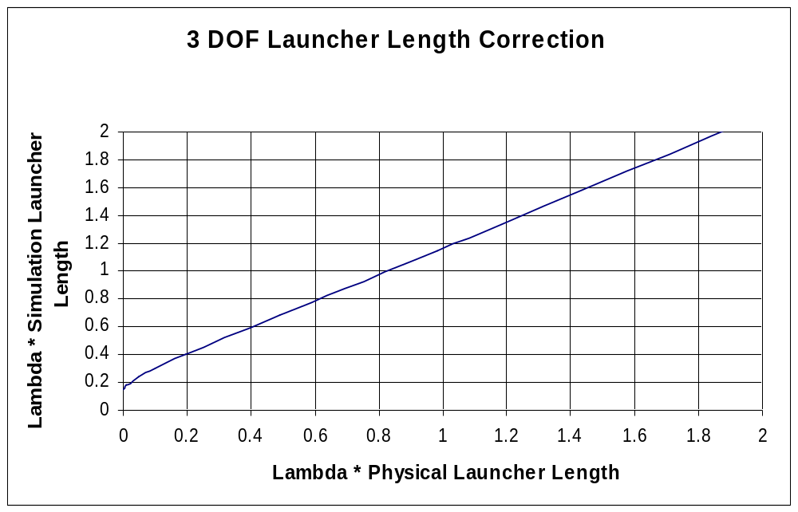
Universal Finite Inertia Correction to Launcher Length
Lambda (λ) is the pitch/yaw wave number at launch
Exact simulation result can be roughly approximated by adding about 7 m ≅ 23 ft to the physical launcher length…SKYAERO uses a more sophisticated curve fit to the data displayed below
Ref: C.P.Hoult, “Launcher Length for Sounding-Rocket Point-Mass Trajectory Simulations”, Journal of Spacecraft and Rockets, Vol. 13, No. 12, Dec. 1976, pp 760-761.

Slide 42
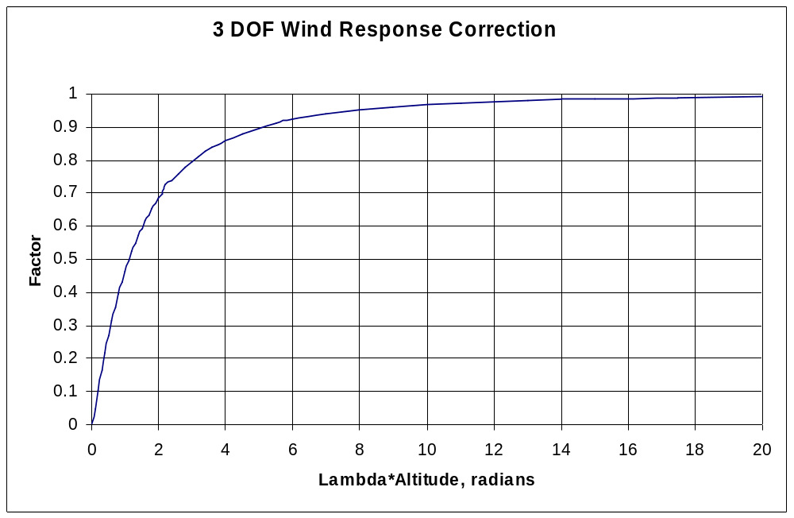
Universal Finite Inertia Wind Correction Factor
Correction Factor derived from singular perturbation (matched asymptotic expansion) technique
  Factor is effectively a micro 6 DOF near the launcher, then
  Patched into Lewis method at higher altitudes
Multiply physical domain wind profile by Factor to obtain a 3 DOF simulation domain wind profile
Lambda is the initial rocket pitch/yaw wave number in radians/meter
Altitude is in meters
Ref: C.P.Hoult, “Finite Inertia Corrections to the Lewis Model Wind Response”, The Aerospace Corp. I.O.C. A79-5434.2-44, 3 August, 1979

Slide 43
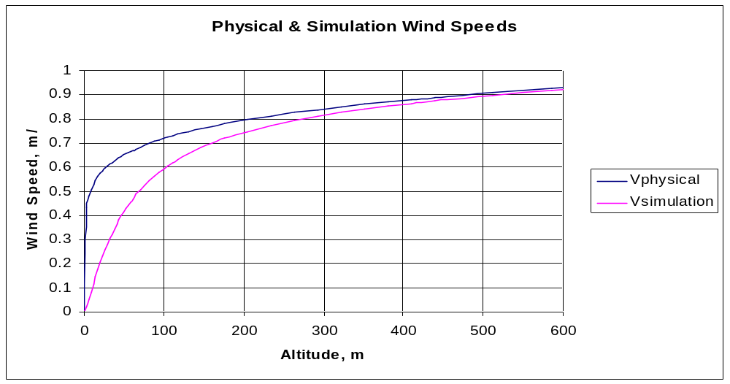
Computation of 3 DOF Simulation Wind Profile
Planetary boundary layer
  1000 m thick; 1 m/s mean wind speed at 1000 m altitude
  Velocity profile is (Altitude/1000)^{1/7}
Lewis method assumes the rocket instantly heads into the relative wind (zero α all the way)
Finite Inertia Correction Factor
  Initial pitch/yaw wavelength of 200 m (on the stiff side)
  Only applied to ascending trajectory leg
3 DOF Lewis method results using Wsimulation closely approximates 6 DOF results using Wphysical
  Wsimulation = Wphysical for descending trajectory leg

